Slide 1
NCMA Certification Information Session
Presented by St. Louis Gateway Chapter
March 7^{th,} 2022

Slide 2
Agenda
- Introductions
- St. Louis Gateway Chapter
- Overview of NCMA Certifications – Brie
- Prep Course Overview – Jody
- Student Experience – Kristi
- How to get Started – Brie
- Q&A

Slide 3


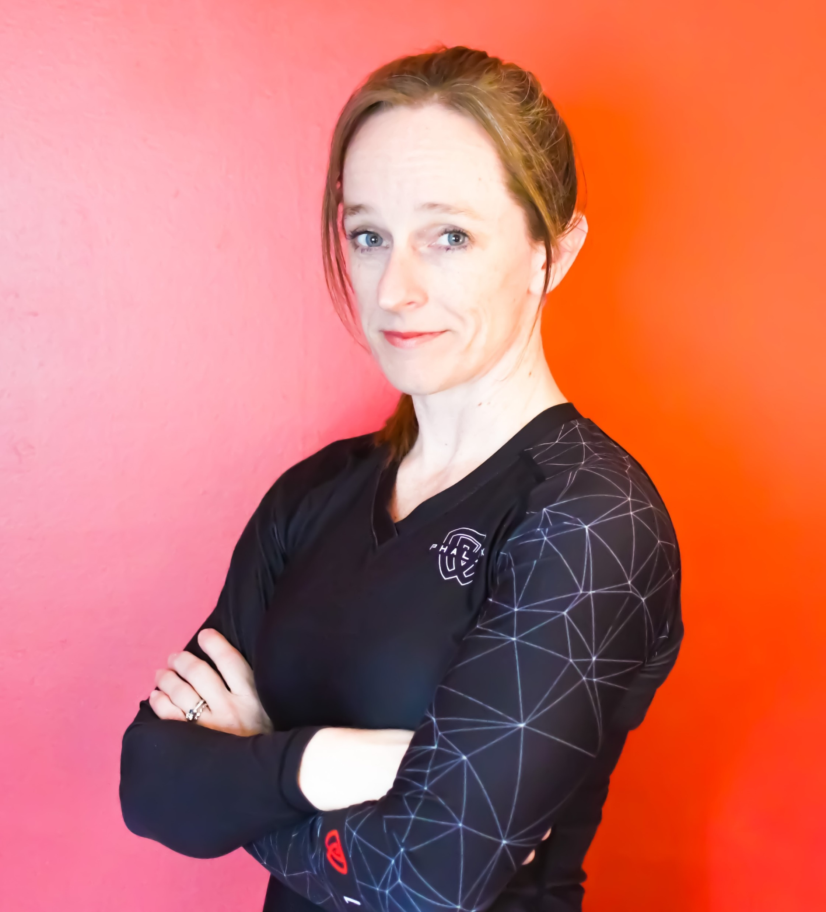
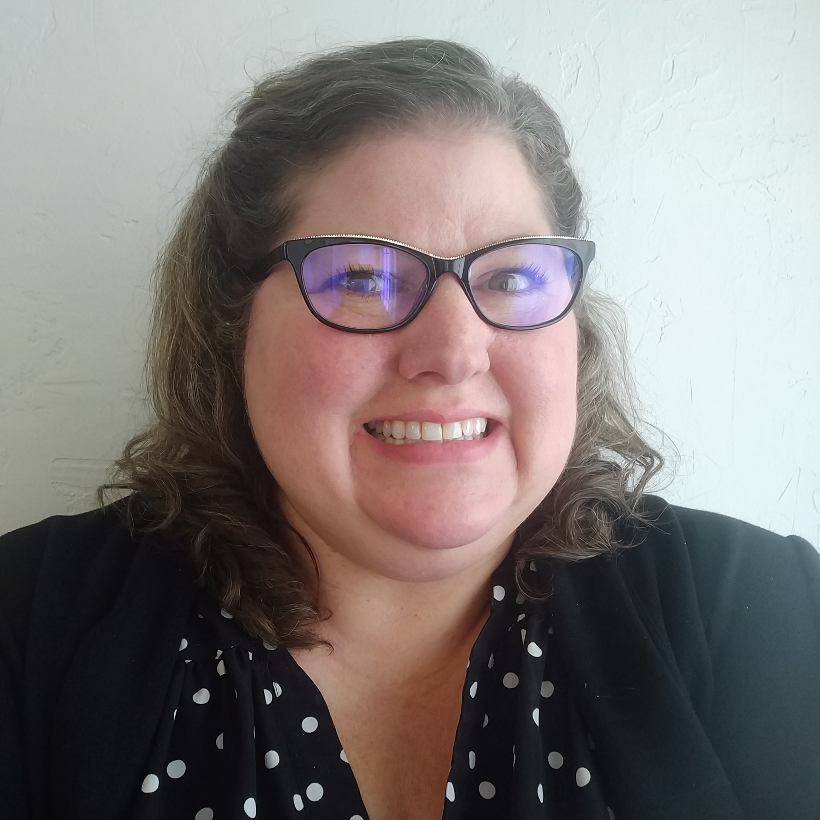
Today’s presenters
Brie Staker, CPCM, CFCM, Fellow, CMLDP Alum
Director, Certification and Standard, NCMA
Dr. Milva Finnegan, CPCM, CCCF, CFCM, Fellow
Director Client Contract Value Center, KPMG
Kristi Russell
Manager Client Contract Value Center, KPMG
Jody Leon
Learning Specialist, NCMA

Slide 4
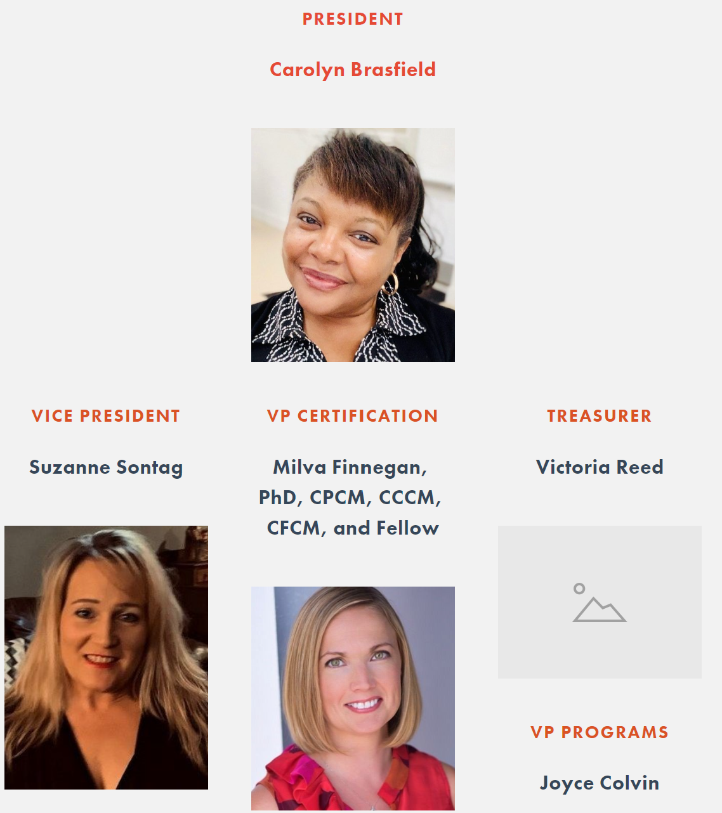

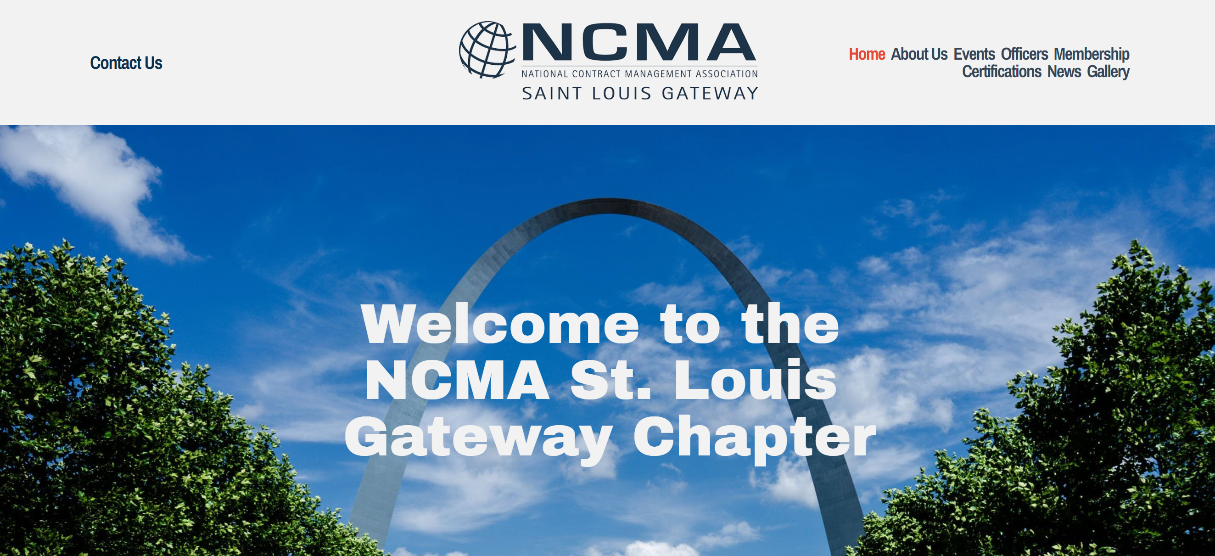
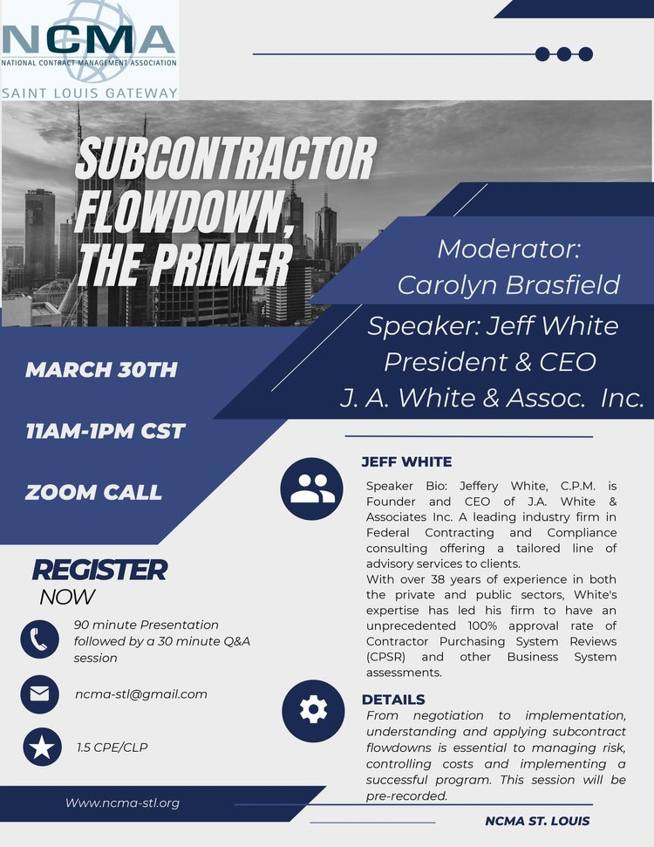
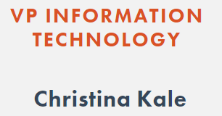
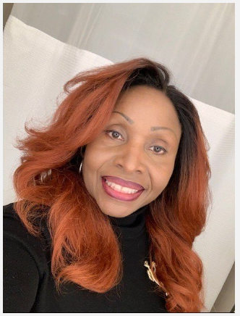
Upcoming Event

Slide 5
NCMA Professional Certification Programs
The professional certification program is designed to elevate professional standards, enhance individual performance, and distinguish those who demonstrate knowledge essential to the practice of contract management.
NCMAHQ.org/certifications is the central place for info https://www.ncmahq.org/certification

Slide 6


NCMA Certifications
March 7, 2023
Notes:
[Welcome and introduction]

Slide 7
Contract Management Certifications
CPCM = Gold Standard
CPCM
CMBOK, 5 yrs exp, 120 CPE/CLP
Competence
Continuous Learning
CFCM
FAR, 2 yr exp,
80 CPE/CLP
CCCM
UCC, 2 yr exp,
80 CPE/CLP
CCMA
CMS™, 1 yr exp OR 4 yr degree, 40 CPE/CLP
CCMA = Universal Certification
Notes:
NCMA has 4 stackable, portable certifications
Though stackable, the certifications do not need to be acquired in any order. Portable means that once the certification in achieved, it can be held in any job.
All are intended to improve competence through continuous learning.
[Briefly review the pyramid. New professionals may be very interested in the CCMA.]

Slide 8
Certifications at a Glance
Certification | Knowledge | Entry Requirements |  |  | Exam Length/ Passing Score | Recertification
CPCM (ANAB Accredited) | CMBOK® | 4-Year Degree | 5 Years of Experience | 120 CPE | 4 hours; 180 Qs (w scenario Qs) 72.2% | 5 years; 100 CPE
CFCM (ANAB Accredited) | FAR | 4-Year Degree (waived w 5yr experience + 24 college hr) | 2 Years of Experience | 80 CPE | 3 hours; 150 Qs 70% | 5 years; 60 CPE
CCCM | UCC
CCMA (ANAB Accredited) | CMSTM | 1 Year of Experience OR 4-Year Degree |  | 40 CPE | 2 hours; 90 Qs 72.5% | 3 years; 40 CPE (re-pass exam every even cycle)

Slide 9

NCMA Certification Phases

Slide 10
Certification Online Preparatory Course (OPC)
Prepare for your CCMA Exam!
Fully self-paced structure - learn on your own schedule
Earn 5 CPE/CLP hours
Access anytime, on any device
90-question practice exam included
Learn More about the CCMA OPC and Register!
Notes:
This course will break down each area of the CMS that you need to know and help you build foundational knowledge in the contract management competencies and skills you need to be successful. The CCMA exam is based on the Contract Management Standard, referred to as the CMS.
This self-paced course will take about 4-5 hours to complete and is designed to help you study for the CCMA certification exam by building foundational knowledge in contract management. By the end of this course, you will earn 5 CPE/CLP and be able to:
Identify the guiding principles of contract management.
Describe the phases, domains, and competencies within the contract life cycle.
Differentiate contract management job tasks between buyers and sellers.
This course serves as a complement to the CMS, with lesson materials, contextualized examples, knowledge checks, and a practice exam to promote your retention of foundational concepts and processes within the field.
As an added bonus, we have included additional CPE/CLP recommendations, resources, and opportunities to further expand your knowledge and professional network and prepare for CCMA certification.

Slide 11
Certification Online Preparatory Course (OPC)
Get Help for your CPCM™ and CFCM™ Exams!
10 short weeks! Spring Session Starts April 3, 2023
Asynchronous learning, lectures are pre-recorded
Access anytime, on any device
Collaborate with your instructor and classmates
Earn 40 CPE/CLP hours - Use the CPE/CLP hours earned towards exam eligibility
CFCM OPC Information and Registration
CPCM OPC Information and Registration

Slide 12
Prep Course Student Experience
Kristi Russell just completed the course!
Q1. Can you give us a brief overview of your experience taking the course?
Q2. Why did you decide to take the course?
Q3. What advice can you give to anyone getting ready to pursue their certification?

Slide 13
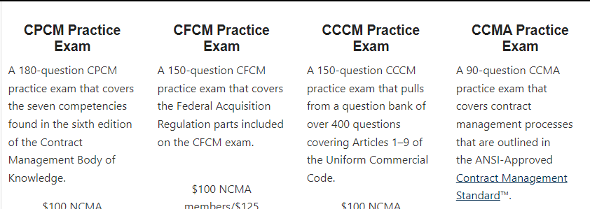
Certification Practice Exams
Visit our Learning Catalog to purchase a practice exam.
**Note: Practice exams are included in all prep courses.

Slide 14
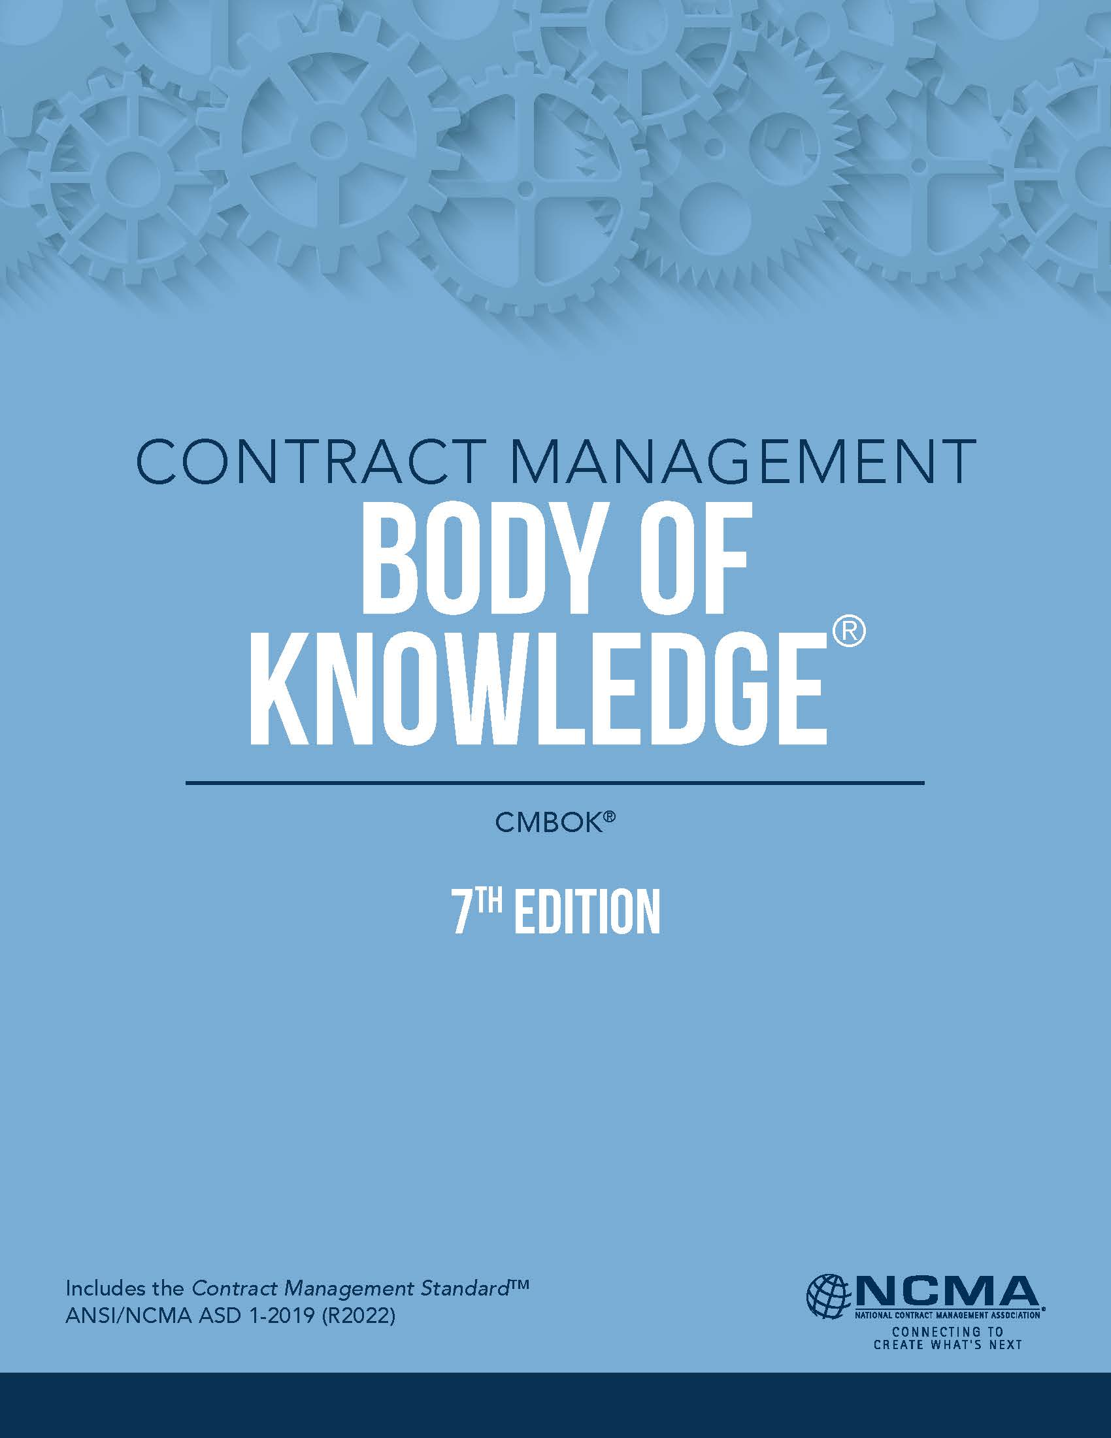
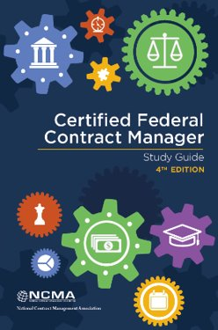
NCMA Bookstore
Online bookstore that offers a variety of reference materials for every step in your career journey!
Popular reference materials include:
Contract Management Body of Knowledge - 7th Edition
Certified Federal Contract Manager Study Guide 4th Edition
Subcontract Management from A to Z-Second Edition
Desktop Guide to Contract Management Terms
Desktop Guide to Key Contract Terms & Conditions
NOW AVAILABLE!

Slide 15
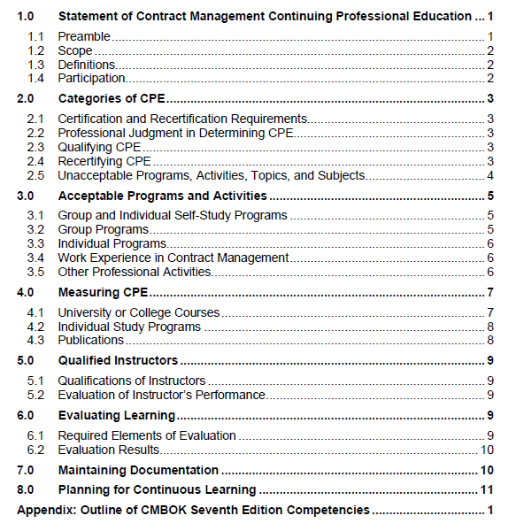
Continuing Professional Education (CPE)
The CPE Guide is your friend.
  Download a free copy: CPE Guide
Three Keys to CPE:
  Qualifying: aligns with CMBOK Competencies
    Section 2.3 and Appendix of CPE Guide
  Timing:
    New Application for Certification: 10 years from date of application for certification
    Recertification Application: within the designated recertification period (outlined in each Certification handbook)
    Section 2.0 Categories of CPEs
  Documentation
    Section 7.0 of CPE Guide outlines supporting documentation requirements.

Slide 16
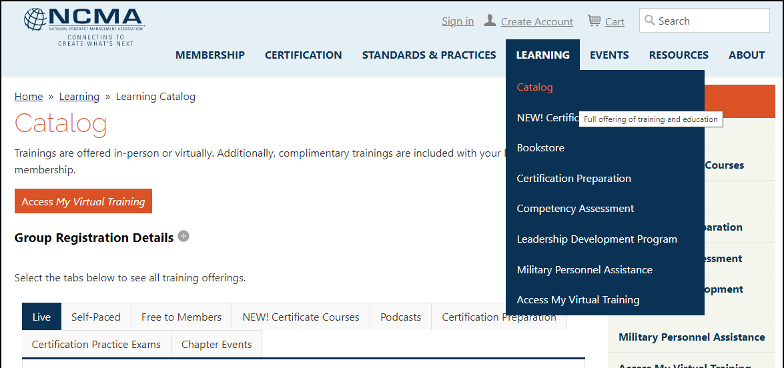
Learning Catalog
Visit our Learning Catalog to see all the virtual trainings NCMA offers.

Slide 17
Upcoming Trainings
Lunchtime Virtual Training Series
March 9: International Contracting - Buy American /Trade Agreements​
March 22: CPE Explained (free to all)
March 23: Vendor Incentives​
April 11: The Contracting Workforce Shortage (free to members)​
​April 13: International Contracting –Export Control Compliance
April 27: Preparing for a Contracting Purchasing System review (CPSR)
May 11: Inflation Economic Price Adjustments (free to members)
May 25: Tracking Performance with a Vendor Scorecard​
Visit our Learning Catalog to see all the virtual trainings NCMA offers.

Slide 18
Upcoming Trainings
SubCon: The Prime Contractor-Subcontractor Partnership​
Immersive deep dive sessions give hands-on practice on essential topics.
Session topics center around the connection points between primes and subs to build powerful relationships.
Includes an overview of the entire federal process and where subcontractors fit in
In-person attendees benefit from more facilitated networking opportunities and resources than ever before!
In-person attendees can earn up to 25 credits
Virtual attendees can earn up to 20 credits
March 29 & March 30, 2023
Learn More and Register at http://ncmahq.org/subcon2023

Slide 19
Upcoming Trainings
Introduction to the Federal Contracting Lifecycle: ​
Getting Small Businesses Ready for 2023​
​
Join this lively, interactive workshop geared to small businesses who are new to federal contracting.​
This workshop is an excellent overview for any prime or subcontractor seeking an introduction or refresher on federal contracting​
Virtual or in-person registration available​
Earn 6 CPEs!​
March 27, 2023
Learn More and Register at http://ncmahq.org/subcon2023

Slide 20
Upcoming Trainings
U.S. Federal Contracting Fundamentals​
Whether you are new or seeking a refresher, this certificate will provide a solid foundation and framework for understanding the context of all the requirements, forms, and systems to navigate as well as insight into how the process really works!​
Live Virtual Training takes place over four consecutive days for 2.5 hours each day. ​
Digital Badge for LinkedIn Profile​
Earn 10 CPE/CLP​
Spring Course: April 17 – April 20, 2023​
from 2:00pm – 4:30pm ET​

Slide 21
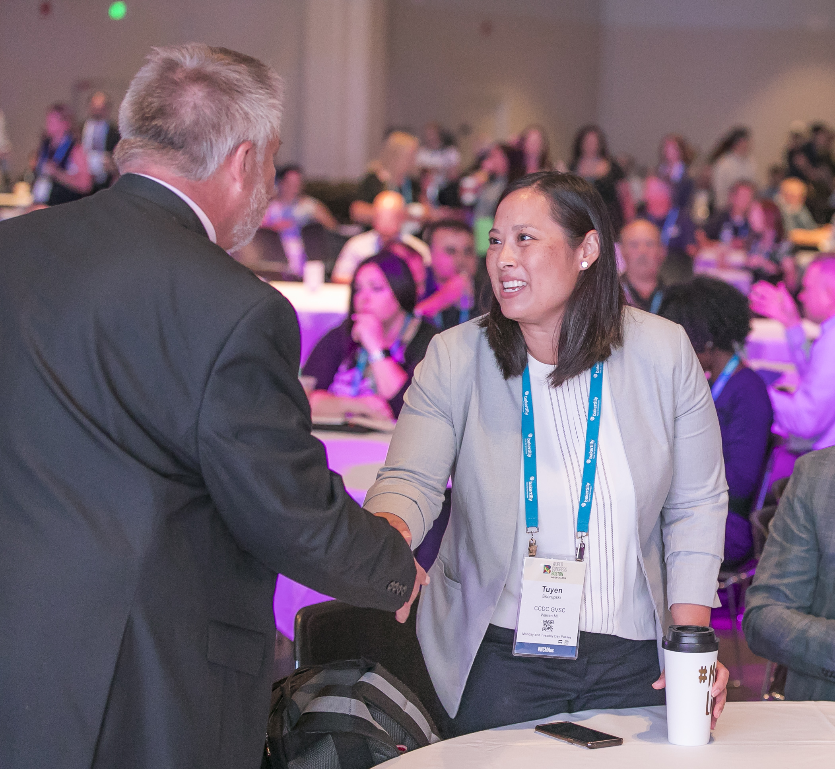
Application Fees
Application:
CPCM™: $225 members; $425 nonmembers
CFCM™: $165 members; $365 nonmembers
CCCM™: $165 members; $365 nonmembers
CCMA™: $90 members; $295 nonmembers
Kryterion Test Centers -
Online Proctored (OLP) and In-Person Exams:
$135 US & Canada
$160 Outside US & Canada
Recertification:
$95 members
$145 nonmembers

Slide 22

Resources and Q&A
NCMA Certifications ncmahq.org/certification
Certification Handbooks
  CPCM ncmahq.org/cpcm
  CFCMncmahq.org/cfcm
  CCCM ncmahq.org/cccm
  CCMA ncmahq.org/ccma
The CPE Guide ncmahq.org/cpe
Online Preparatory Courses (OPC) ncmahq.org/opc
Learning Catalog ncmahq.org/catalog
SubCon 2023 ncmahq.org/subcon2023
Jody Leon, Learning Specialist
  memberservices@ncmahq.org
Brie Staker, Director of Certification & Standards
KwaNitria Denny, Certification Specialist
Demi Breece, Contract Support, Certifications
  certification@ncmahq.org

